Slide 1
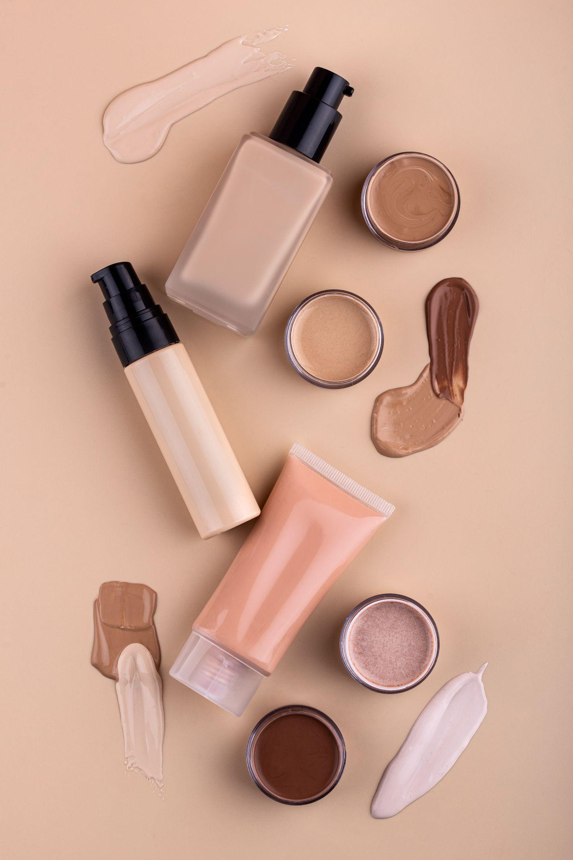

Natural Nourishment - Supply Chain Data Analysis
.

Slide 2
Today’s Agenda
01
02
03
04
05
.
Project Recap
Business Problem
Process
Insights
Summary
.

Slide 3

01
Project Recap

Slide 4
Project Recap
About Company
Our focus points:
Natural Nourishment is a fast growing beauty firm
They need to track down their production and supply chain in market to expand their market at global level
To achieve Natural Nourish’s goal, we have been focusing on the following tasks:
Analysing their production and sales
Analysing Quality/Defect issues
Correlating the cost and sales analysis with the leading time required
Recommending measures for improving customer experience

Slide 5
Problem Statement:
Cost Analysis
Sales Analysis
Quality Analysis
Shipping Analysis
Most costly products to produce?
2. Average lead times for
different products?
3. Production Volume
Total Units Sold per category
How does production lead time affect supply
chain?
Overall profitability
(revenue - costs) for each
product?
What is the average defect rate for each product type?
How do defect rates correlate with inspection results ?
Most common transportation used and how does it affect cost and time?
2. Which locations have maximum shipping orders

Slide 6
Process :
1
Data Understanding
2
Data Cleaning
3
Data Modelling
4
Data Analysis
5
Key Insights
.
.
.

Slide 7

52,925
5,77,605
5,24,680
Insights
Total Production Costs
Total Revenue Generated
Total Profit
15(days)
Average Manufacturing lead time
7.62
Average Defect Rate

Slide 8
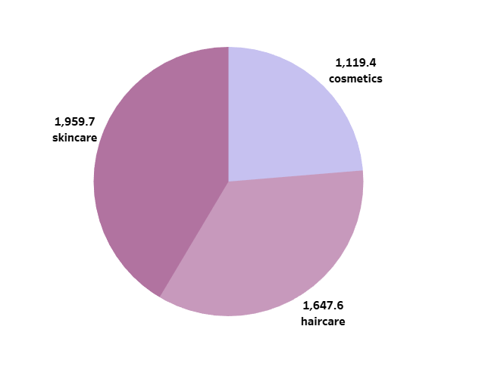
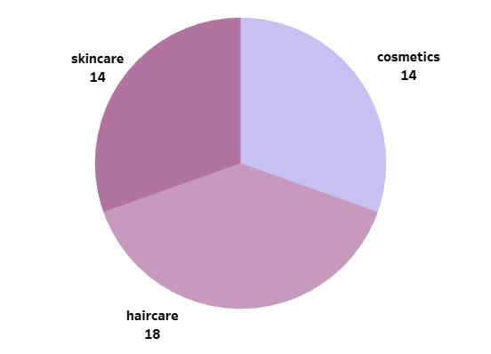
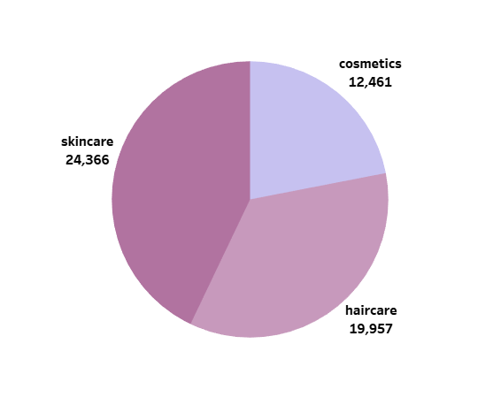
Production Analysis
Production Costs
Production Lead Time
Production Volume

Slide 9
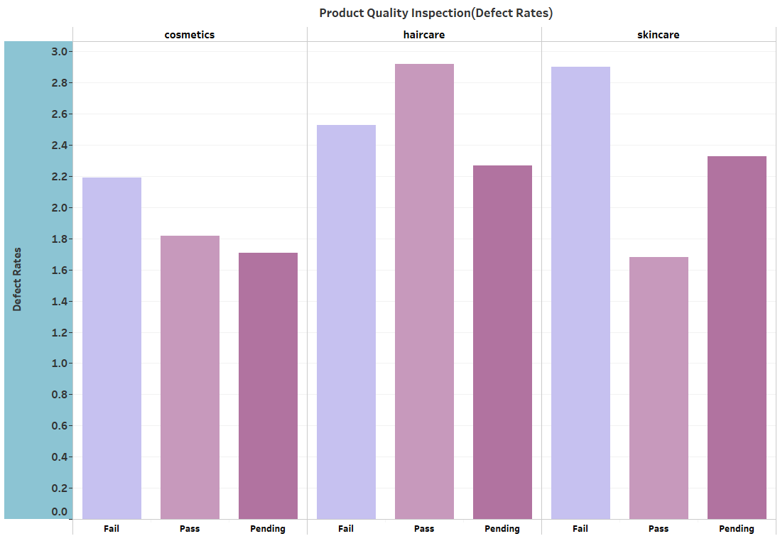
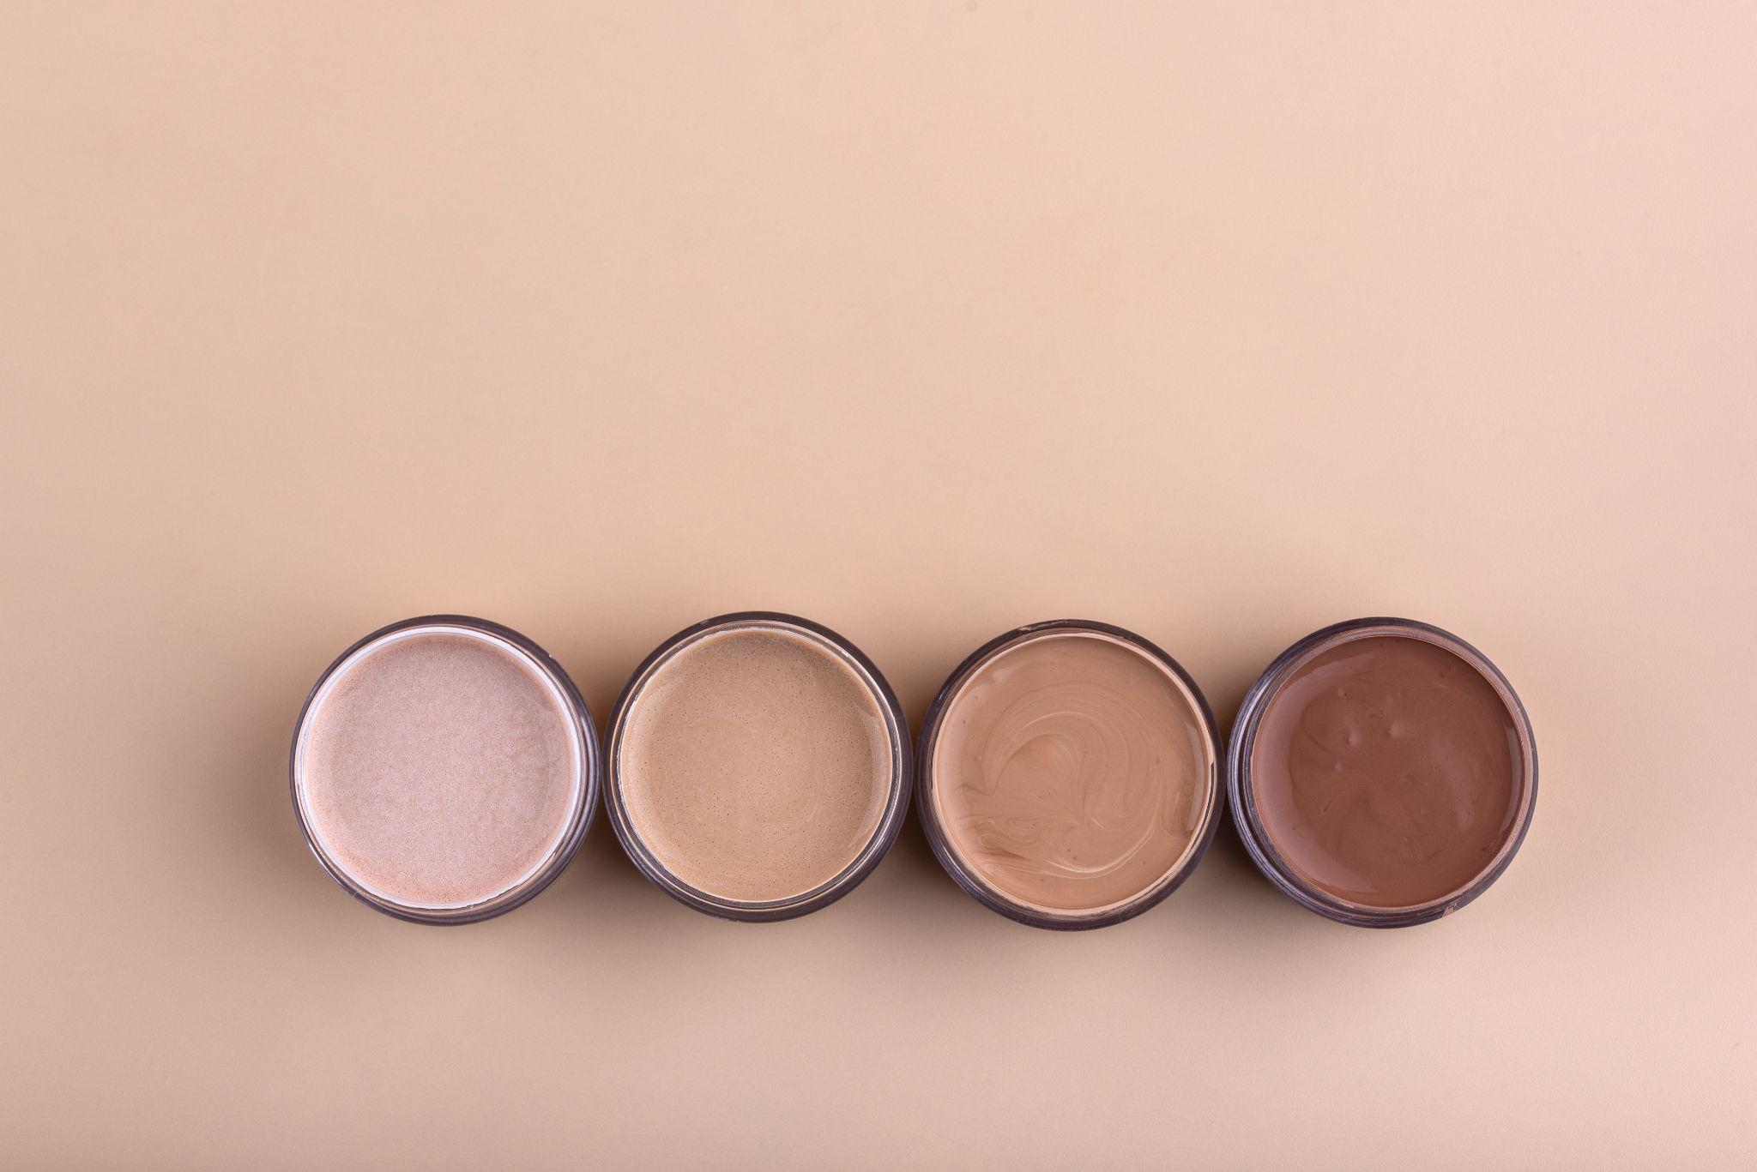
Average Defect Rates

Slide 10
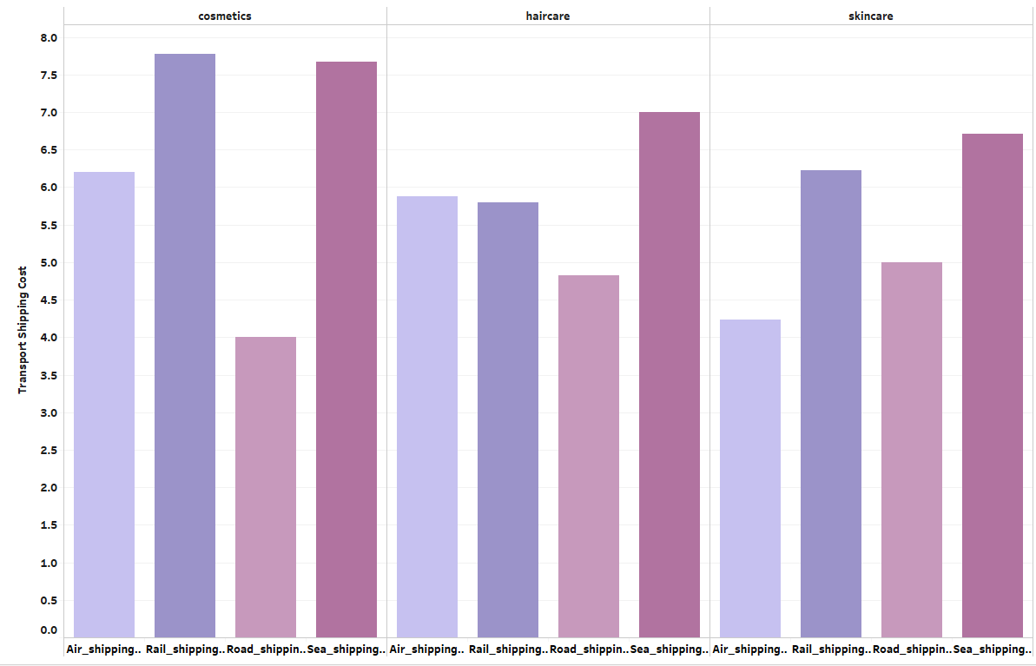
Shipping Analysis
Q1
Q2
Q3
Q4
January -arch
April - June
July - September
October - December
Follow the link in the graph to modify its data and then paste the new one here. For more info, click here
Transportation Cost

Slide 11
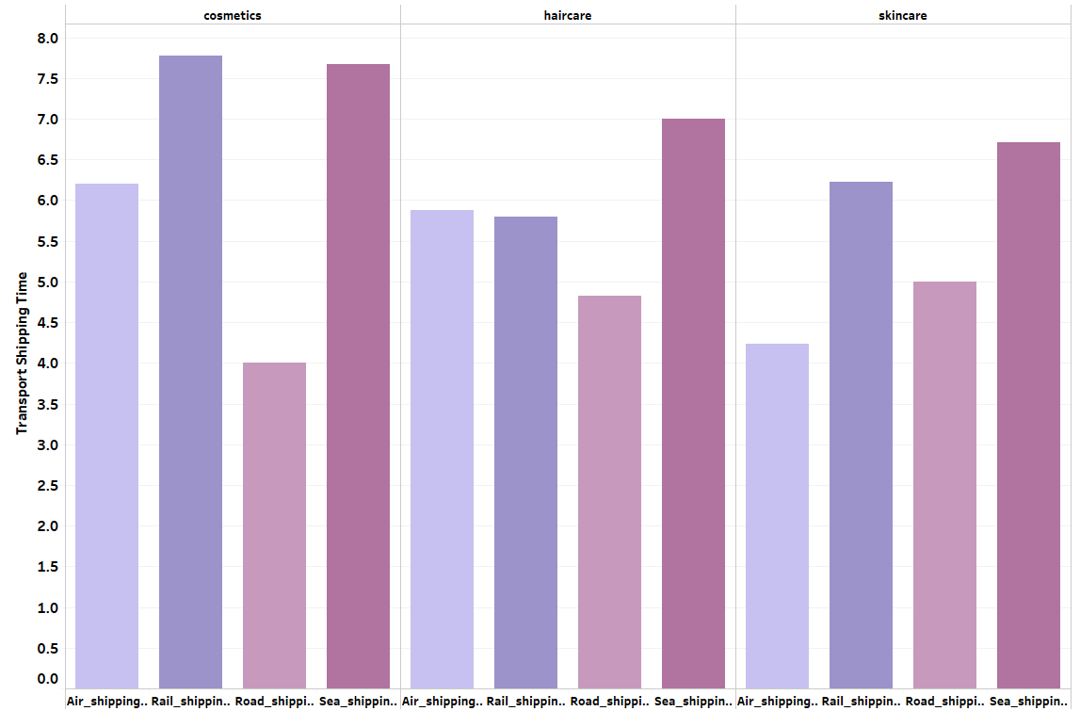
Shipping Analysis
Q1
Q2
Q3
Q4
January -arch
April - June
July - September
October - December
Follow the link in the graph to modify its data and then paste the new one here. For more info, click here
Transportation Time

Slide 12
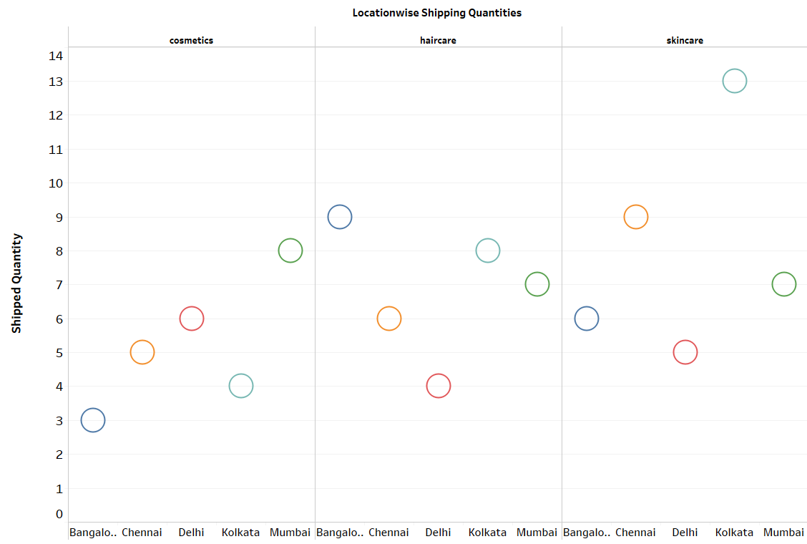
Shipping Analysis
Q1
Q2
Q3
Q4
January -arch
April - June
July - September
October - December
Follow the link in the graph to modify its data and then paste the new one here. For more info, click here
Shipped Quantity Time

Slide 13
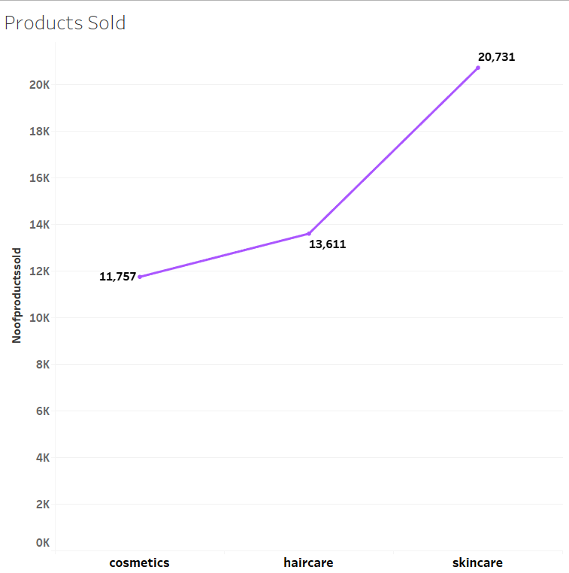
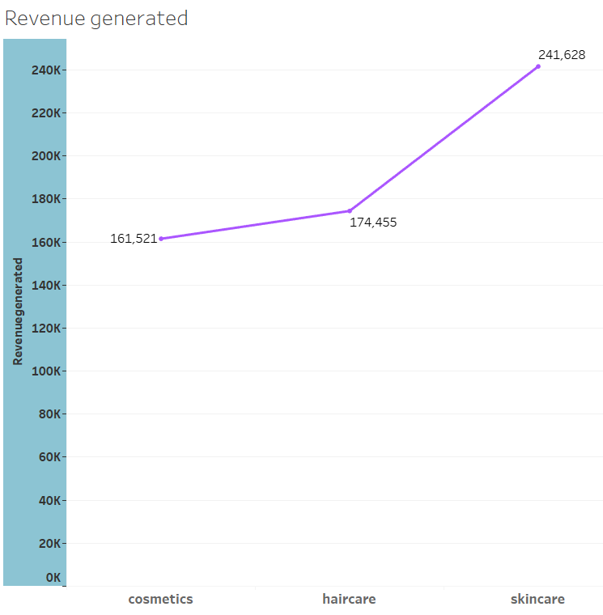
Sales Analysis
.
Production Sales
Revenue generated
.

Slide 14

Key Insights
Production
Shipping
Skincare products are 10-15% more costlier than other beauty products
Haircare products require more manufacturing time
Road Transportation is found best suitable way for shipping goods within time and at cheaper costs
.
.
Sales
.
Top profitable Products are skincare products
Profit Margin :
Skincare - 41.82%
Haircare -29.95%
Cosmetics -28.24%
.
Quality
Defect rates are overall less(2.54%) for all 3 brand types with skincare and haircare category having bit higher defect rates

Slide 15
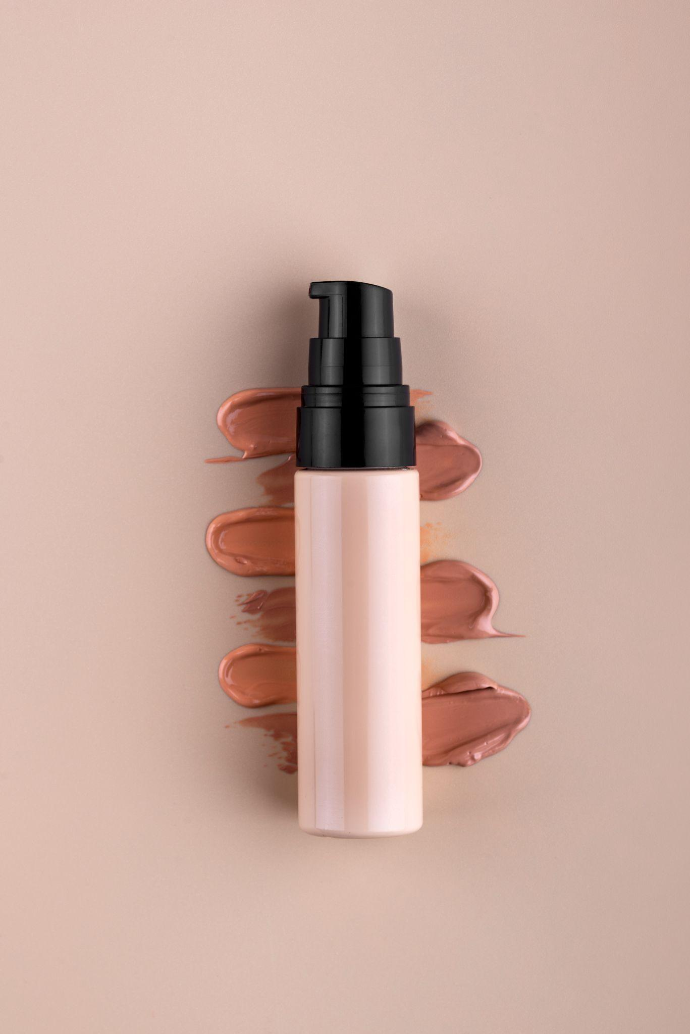
Summary
Top in demand products among consumers are skincare products
Average production time for haircare products is more which is why shipping time increases
Road transportation proves the best profitable way for transporting goods at reasonable cost and within order time
Shipping lead times can be reduced by managing production lead time and improving stock availability
Overall profit and sale for haircare and cosmetic categories can be improved by reducing lead times and defect rates
Finally you can use these insights to improve the customer experience and increase customer engagement

Slide 16



Thanks!
Do you have any questions?
shindemanasi310@gmail.com
For complete dashboard code follow my github profile

